Slide 1













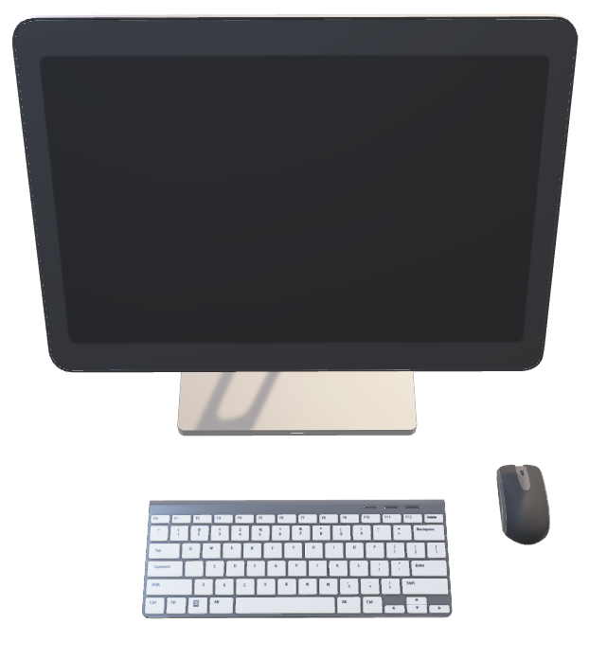
Login / AAI
Cloud
Storage
Compute Resources
Software & Tools
Policies

Slide 2


Login / AAI
Cloud
Storage
Compute Resources
Software & Tools
Policies
SFB xxx
ERC yyy

